Slide 1

Battery power

Slide 2
Inhoud
Onderzoeksmethode
9V batterijen
AA batterijen
Battery recharging module/shield
Voltage regulator
Battery power circuit
Conclusie

Slide 3

Onderzoeksmethode
Literatuur
Winkels bezoeken

Slide 4
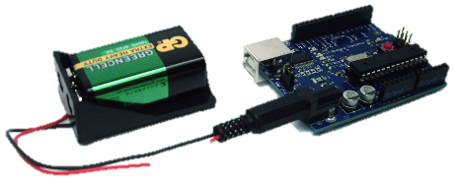
9V batterijen
9V Battery | Alkaline | Zinc-carbon | Lithium | NiMH | Lithium polymer | Lithium-ion
Capacity | 550 mAh | 400 mAh | 1200 mAh | 175-300 mAh | 520 mAh | 620 mAh
Voltage | 9 V | 9 V | 9 V | 7.2-9.6 V | 7.4 V | 7.4 V
Rechargeable | No | No | No | Yes | Yes | Yes
9V Battery | Price
Alkaline | €1.95 p.p.
Zinc-carbon | €1.95 p.p.
Lithium | €6.95 p.p.
NiMH | €7.95 p.p.
Lithium polymer | €7.49 p.p.
Lithium-ion | €6.90 p.p.

Slide 5
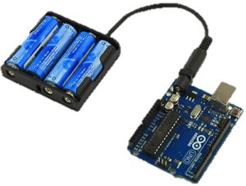
AA batterijen
AA Battery | Zinc–Carbon | Alkaline | Li-FeS | Li-ion | NiCd | NiMH | NiZn
Capacity | 400–1700 mAh | 1800-2850 mAh | 2700-3400 mAh | 600-2200 mAh | 600-1000 mAh | 600-2750 mAh | 1500-2500 mAh
Voltage | 1.5 V | 1.5 V | 1.5 V | 3.6-3.7 V | 1.2 V | 1.2 V | 1.6-1.65 V
Rechargeable | No | Some | No | Yes | Yes | Yes | Yes
AA Battery | Price
Zinc-Carbon | €0.29 p.p.
Alkaline | €0.38 p.p.
Li-FeS | €2.99 p.p.
Li-ion | €3.20 p.p.
NiCd (niet meer toegestaan) | €1.20 p.p.
NiMH | €1.82 p.p.
NiZn | €3.11 p.p.

Slide 6
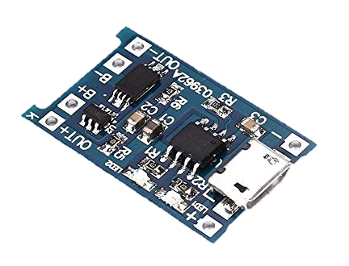
Battery recharging module/shield
Ni-ion
Bescherming
Geen vlam

Slide 7
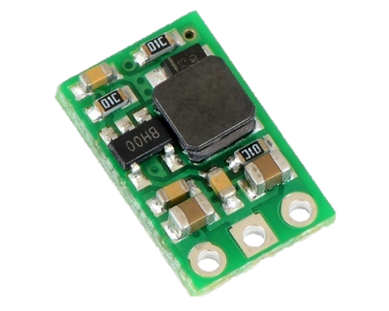
Voltage Regulator
2.5V – 5V
Beter opwaarderen
Gelijkwaardig
kosten

Slide 8
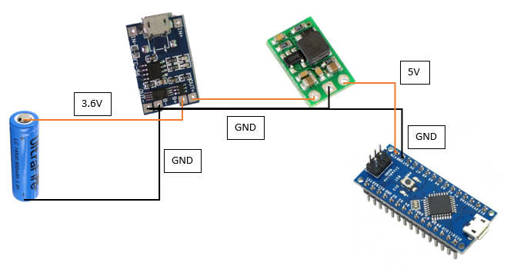
Battery power circuit

Slide 9
Conclusie
AA batterij
Li-ion
Meer nodig dan verwacht

